Slide 1
Java Programming Mini Project {
forbeginners.html
workshop.css
[Mine Sweeper]
}
Programming Language

Slide 2
Table Of ‘Contents’ {
01
02
03
forbeginners.html
workshop.css
MineSweeper introduction
Schematic
Major Function
04
Additional Features
05
Role Sharing
}

Slide 3
01 {
[MineSweeper Introduction]
forbeginners.html
workshop.css
<Introduce Game rule>
}
Programming Language

Slide 4
Rules < /1 > {
forbeginners.html
workshop.css
<All minesweeper games begin with an empty square grid. When you click on one of the squares, some squares disappear, some squares become empty, and some squares display numbers. You need to use these numbers to figure out what is safe and where the mines are in the empty square. >
}
Rules < /2 > {
< All you need is a mouse to find landmines. Click the mine-free square with the left mouse button, and then use the right mouse button to put the flag on the mine-free square.>
}
Programming Language

Slide 5
Rules < /3> {
forbeginners.html
workshop.css
< The square number means the number of mines buried in the adjacent square. For example, if there are two squares lined up, and the number 1 is written on one square, the square next to it is filled with landmines.>
}
Programming Language

Slide 6
02 {
[Schematic]
forbeginners.html
workshop.css
}
Programming Language

Slide 7
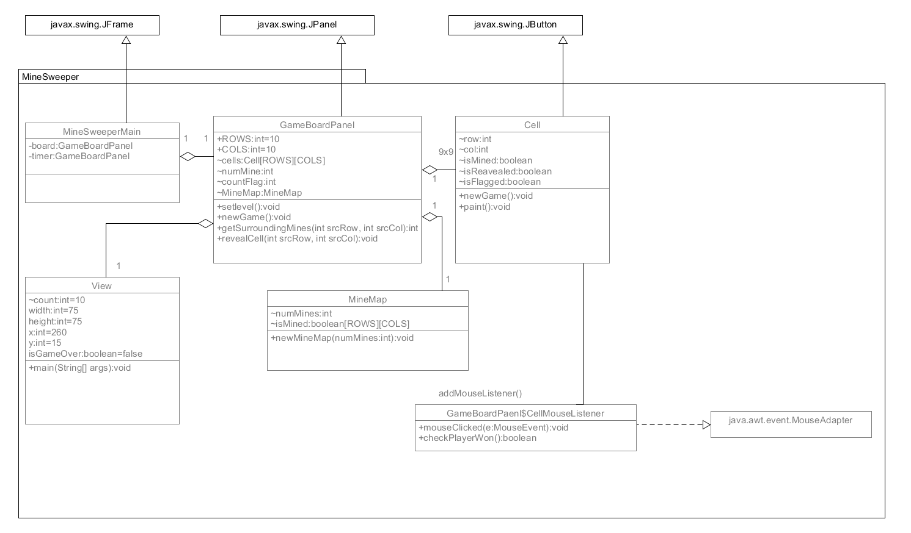
Schematic; {
forbeginners.html
workshop.css
}
Programming Language

Slide 8
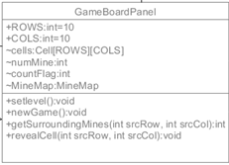
GameBoardPanel class{
forbeginners.html
workshop.css
to hold the grid of 10x10 Cells Similar to Cell, the GameBoardPanel has its own methods to paint() itself
}
Programming Language

Slide 9
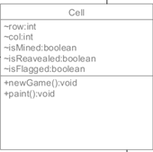
Cell class{
forbeginners.html
workshop.css
imports JButton to make up cells with mines and cells without them, flags, and mines. It's the game screen
}
Programming Language

Slide 10

MineMap class{
forbeginners.html
workshop.css
It is a class that randomly arranges landmines.
}
Programming Language

Slide 11
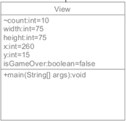
View class{
forbeginners.html
workshop.css
Class to create a timer for a landmine game
}
Programming Language

Slide 12

MineSweeperMain class{
forbeginners.html
workshop.css
Main class to run MineSweeper
}
Programming Language

Slide 13
03 {
[Major Function]
forbeginners.html
workshop.css
}
Programming Language

Slide 14
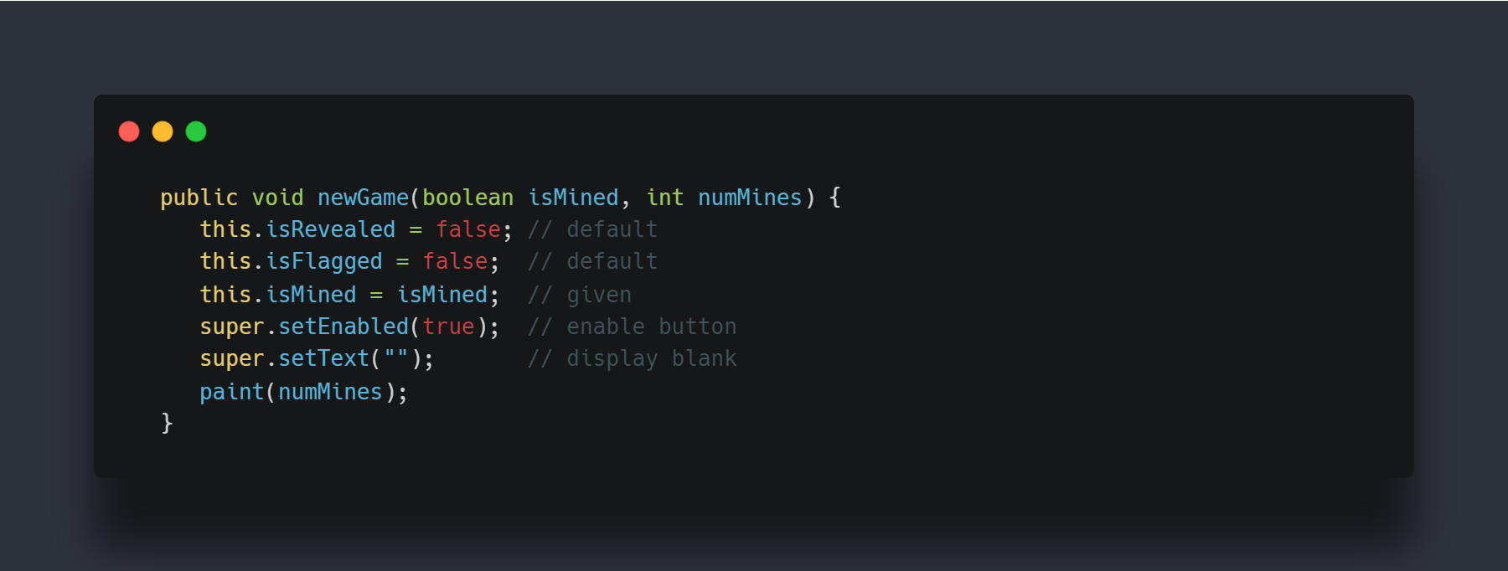
Major Function {
forbeginners.html
workshop.css
Ability to initialize cells
}
Programming Language

Slide 15
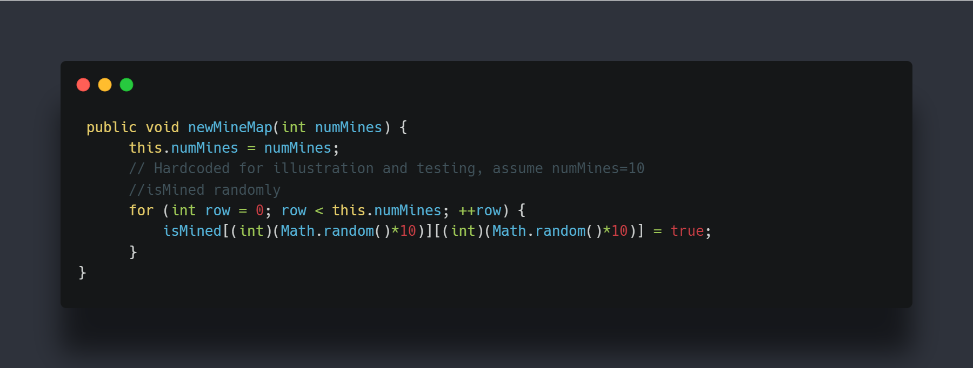
Major Function {
forbeginners.html
workshop.css
Ability to set landmines randomly
}
Programming Language

Slide 16
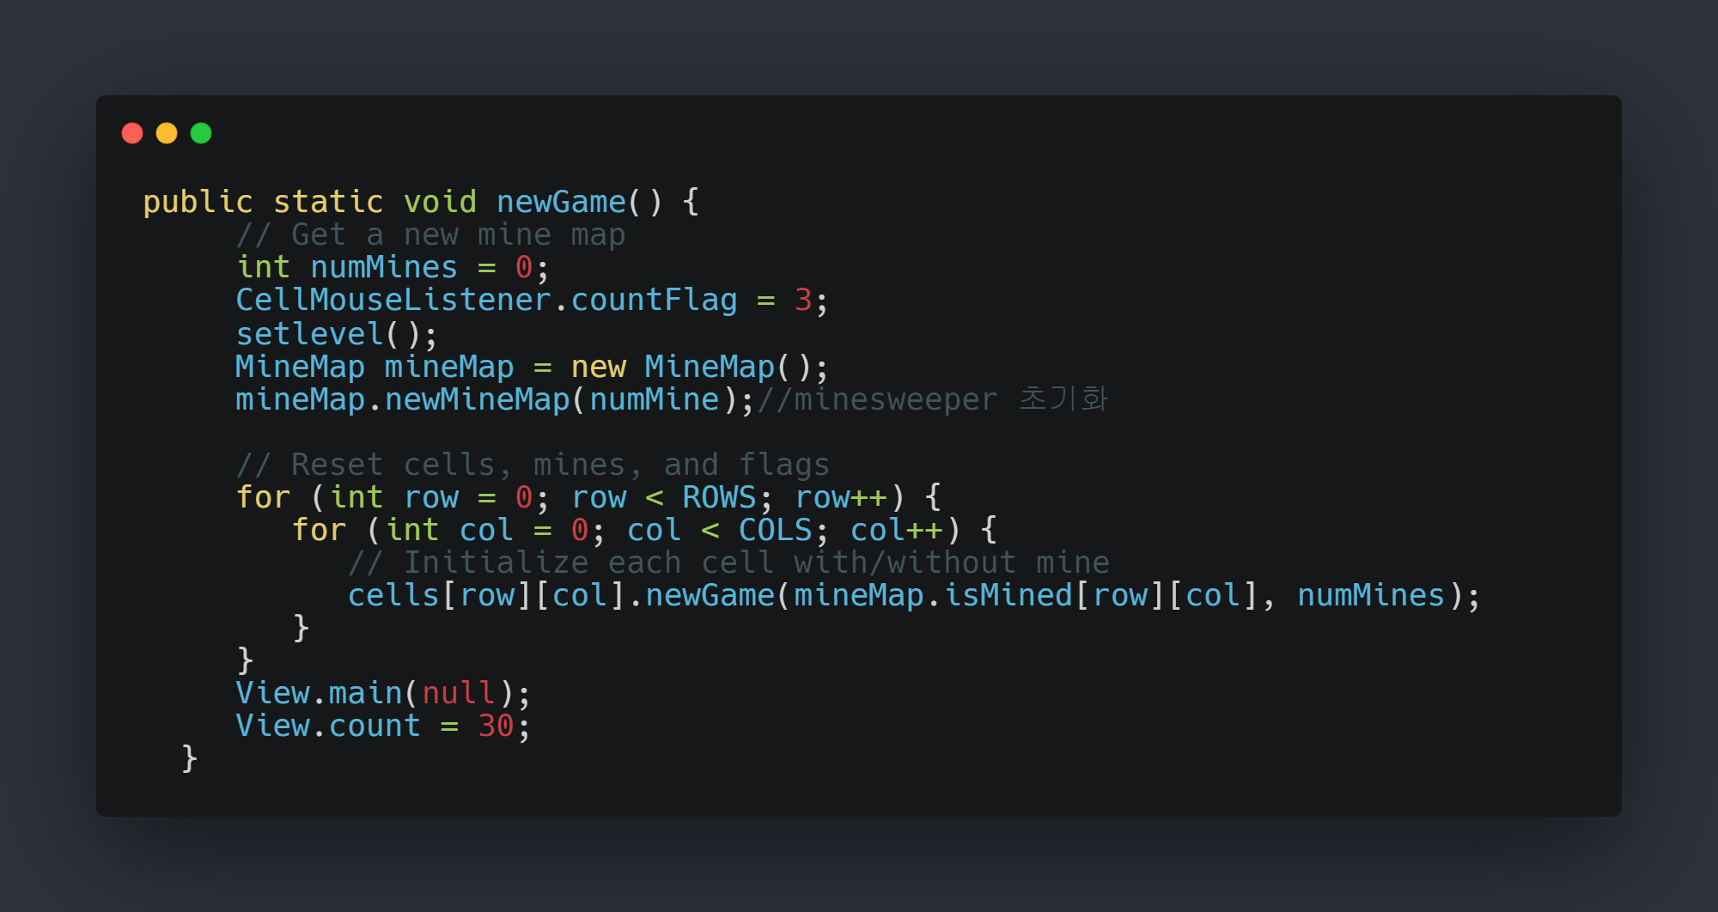
Major Function {
forbeginners.html
workshop.css
Ability to initialize Game
}
Programming Language

Slide 17
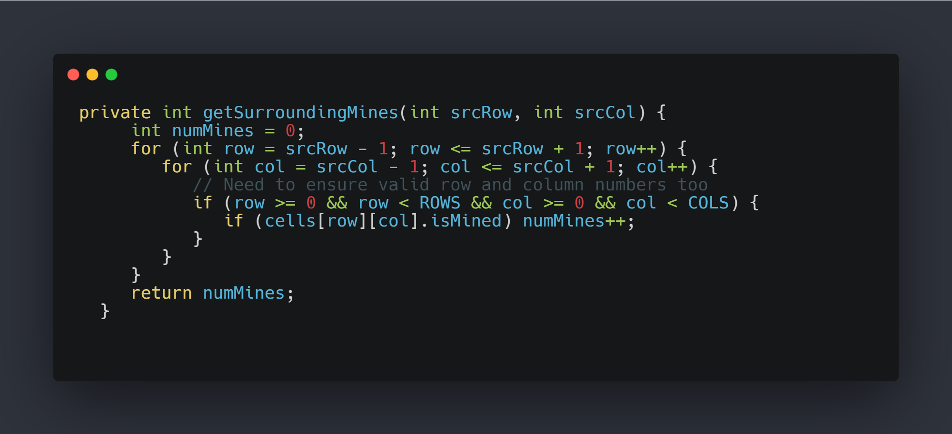
Major Function {
forbeginners.html
workshop.css
Ability to identify the number of mines around me
}
Programming Language

Slide 18
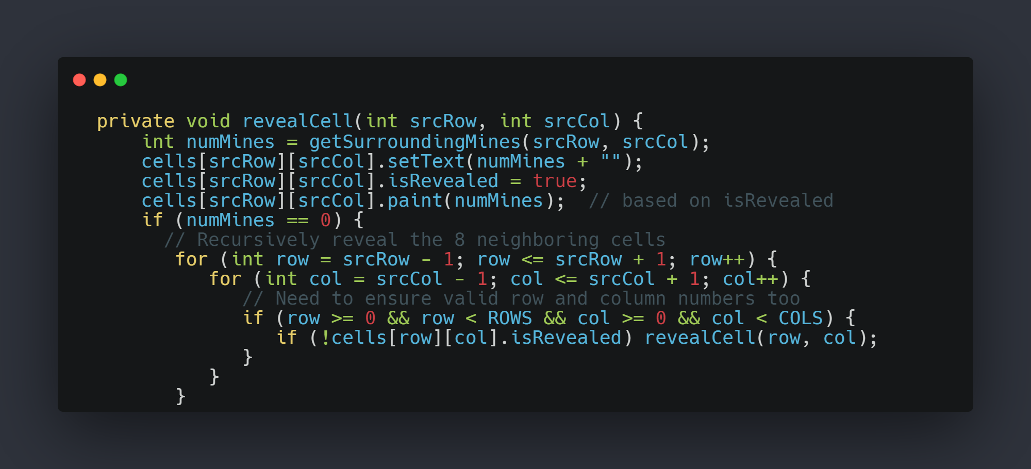
Major Function {
forbeginners.html
workshop.css
Ability to reveal cells that are not landmines in a row
}
Programming Language

Slide 19
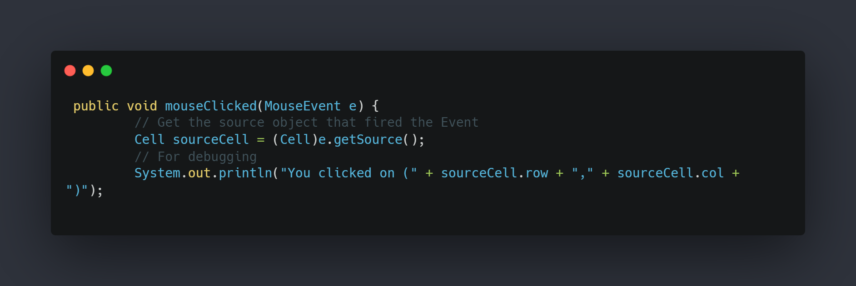
Major Function {
forbeginners.html
workshop.css
Button selection function
}
Programming Language

Slide 20
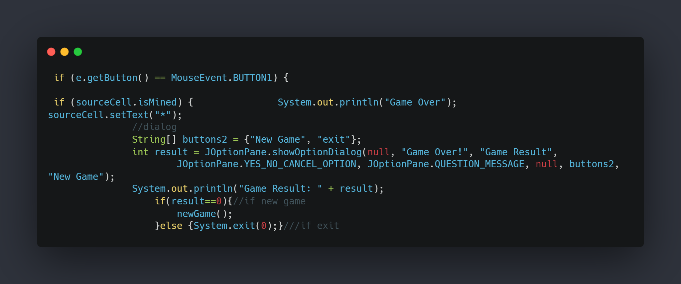
Major Function {
forbeginners.html
workshop.css
Left mouse click –check is Mined
}
Programming Language

Slide 21
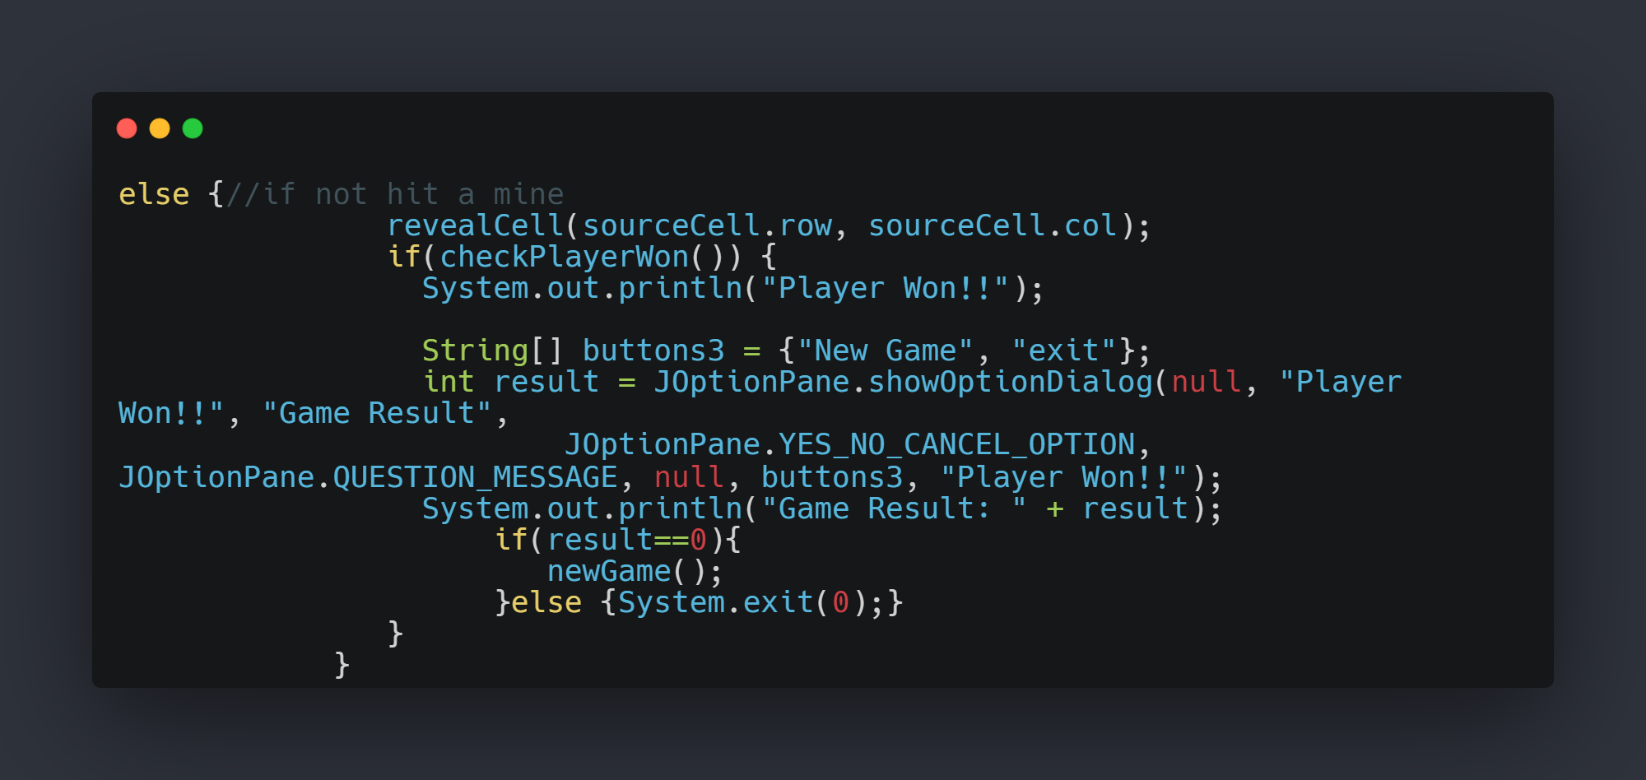
Major Function {
forbeginners.html
workshop.css
Left mouse click –check is Mined
}
Programming Language

Slide 22
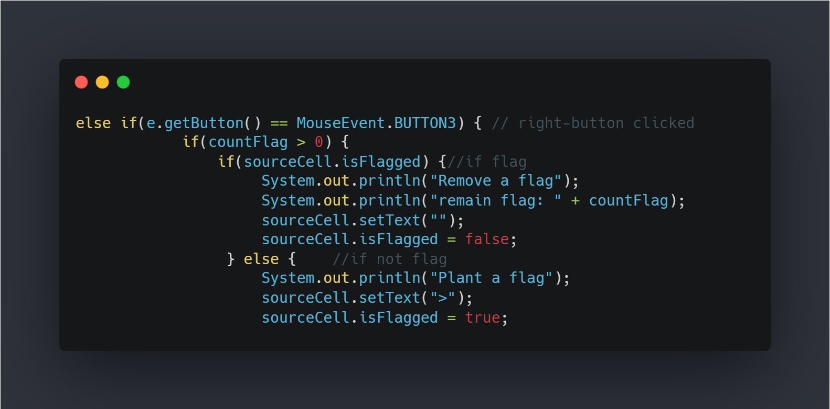
Major Function {
forbeginners.html
workshop.css
Right mouse click –isFlagged check
}
Programming Language

Slide 23
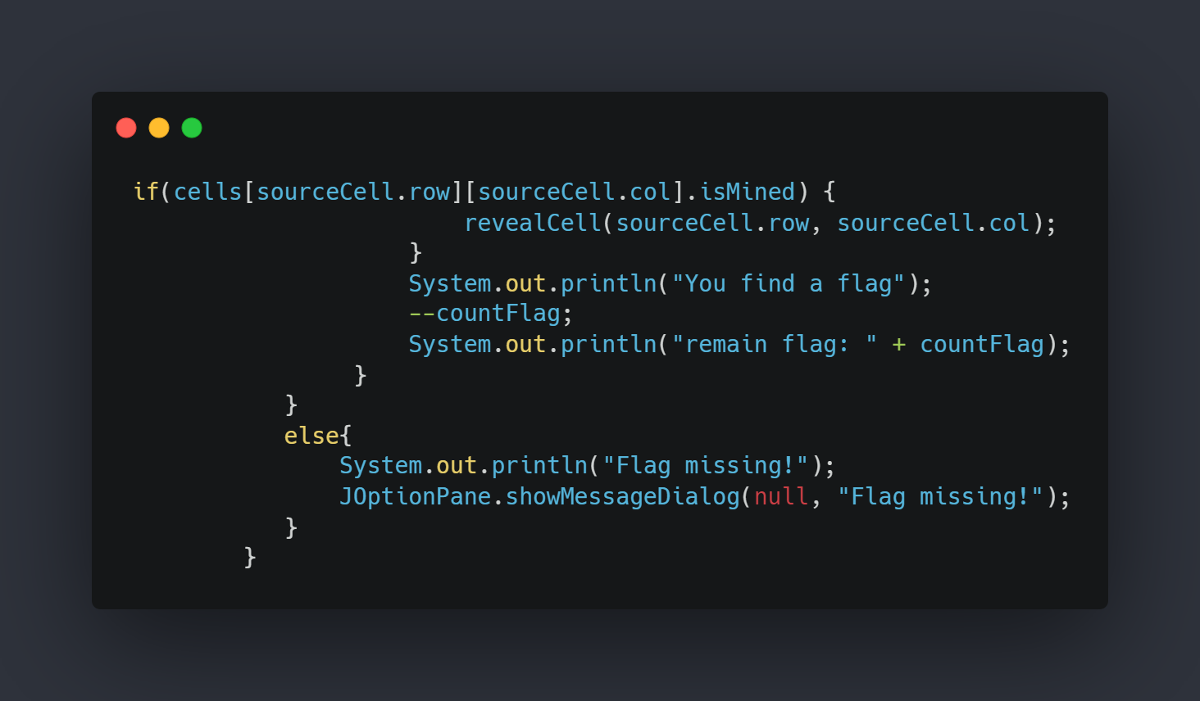
Major Function {
forbeginners.html
workshop.css
Right mouse click –isFlagged check
}
Programming Language

Slide 24
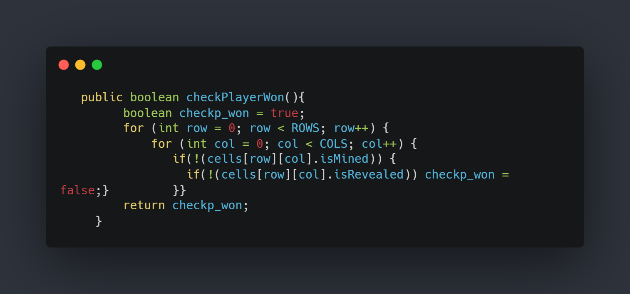
Major Function {
forbeginners.html
workshop.css
Ensure that the player has turned all cells
}
Programming Language

Slide 25
04 {
[Additional Features]
forbeginners.html
workshop.css
}
Programming Language

Slide 26
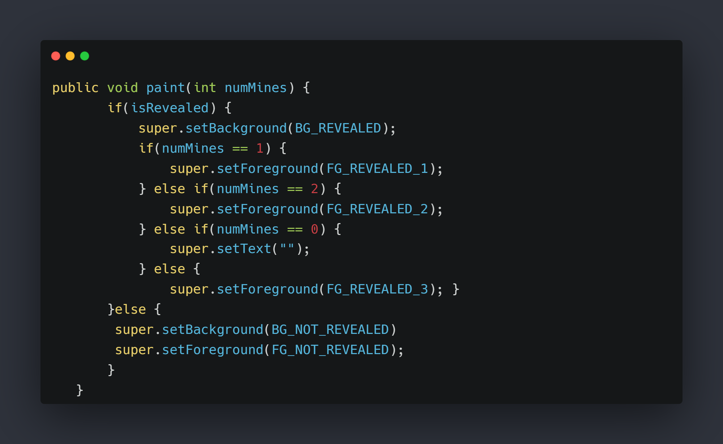
Additional Features {
forbeginners.html
workshop.css
Colour dependent features of landmines
Source Code photo
}
Programming Language

Slide 27
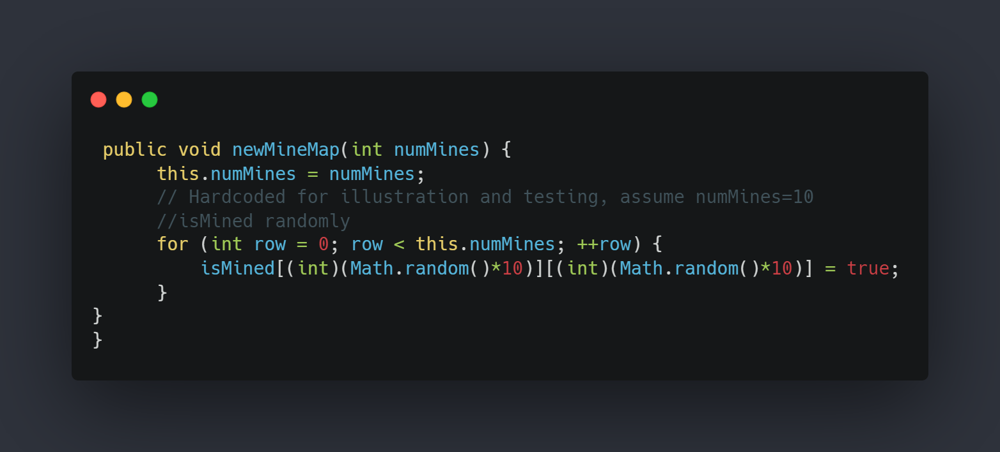
Additional Features {
forbeginners.html
workshop.css
Ability to set landmines at random
Source Code photo
}
Programming Language

Slide 28
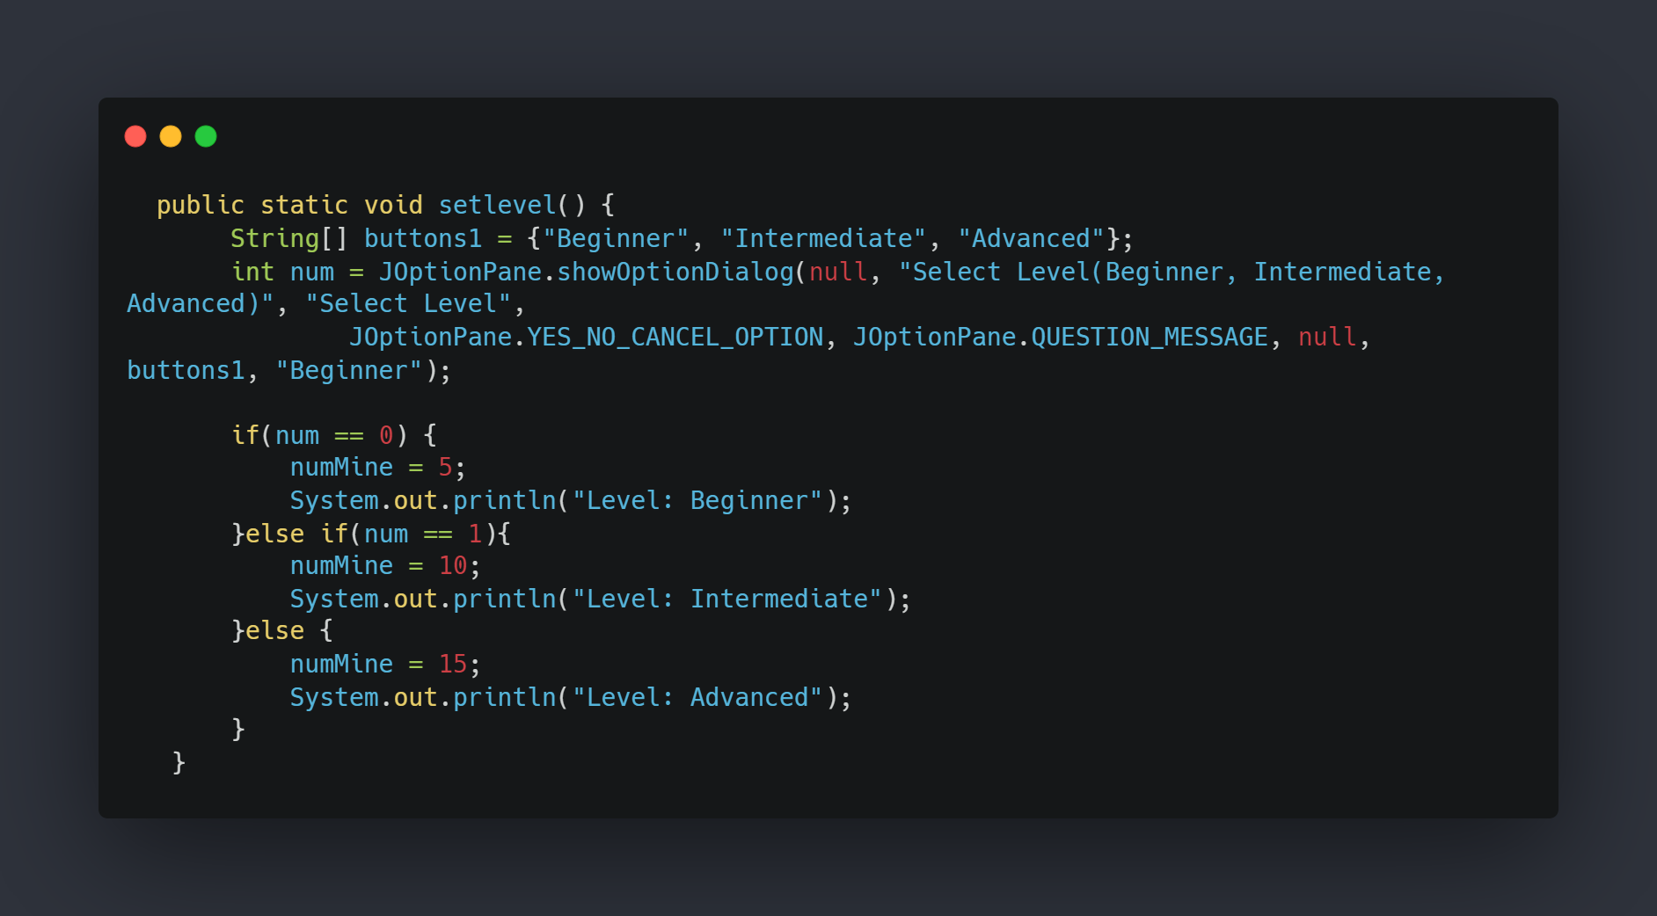
Additional Features {
forbeginners.html
workshop.css
Ability to select level
Source Code photo
}
Programming Language

Slide 29
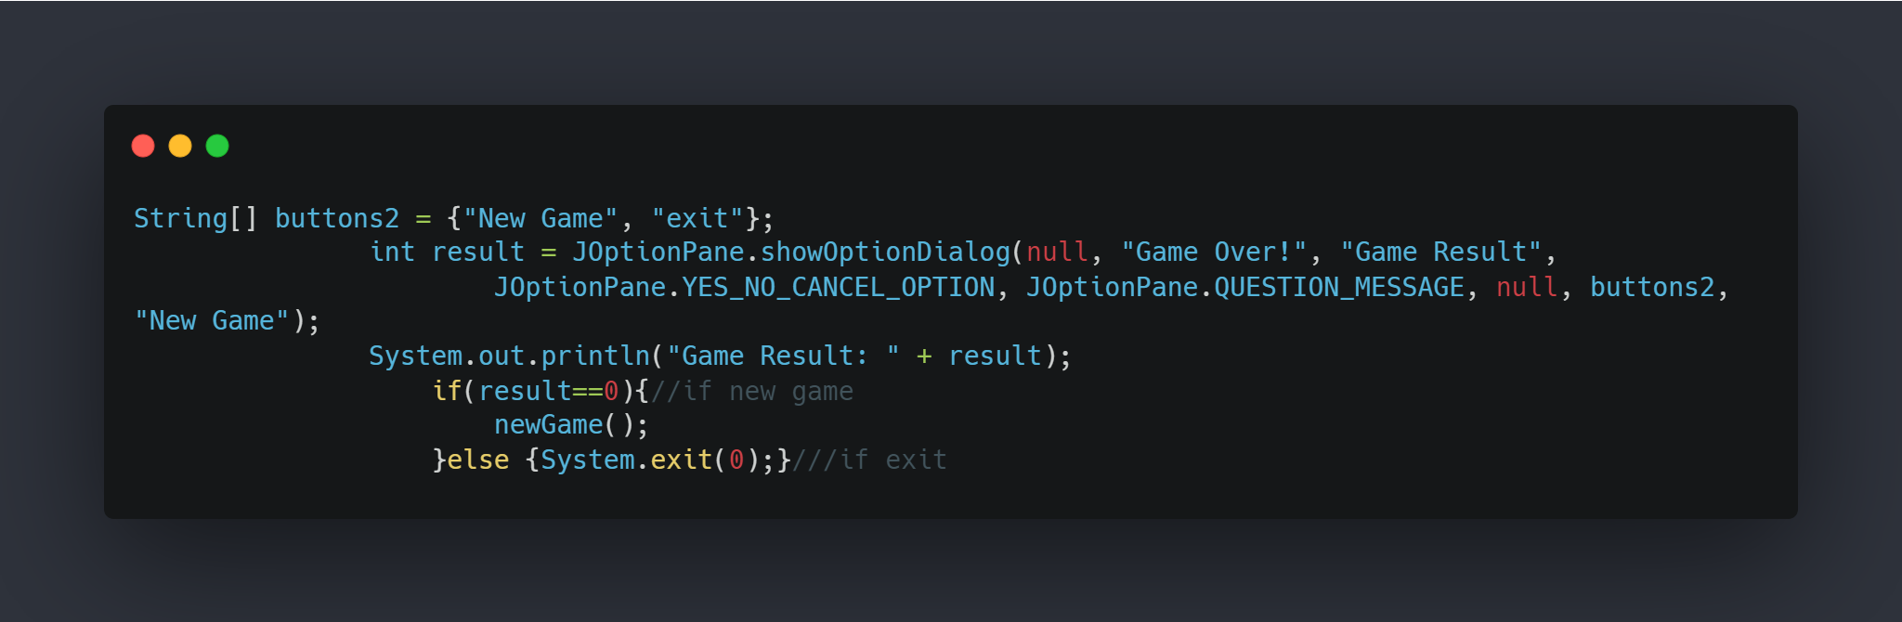
Additional Features {
forbeginners.html
workshop.css
Ability to dialog
Source Code photo
}
Programming Language

Slide 30
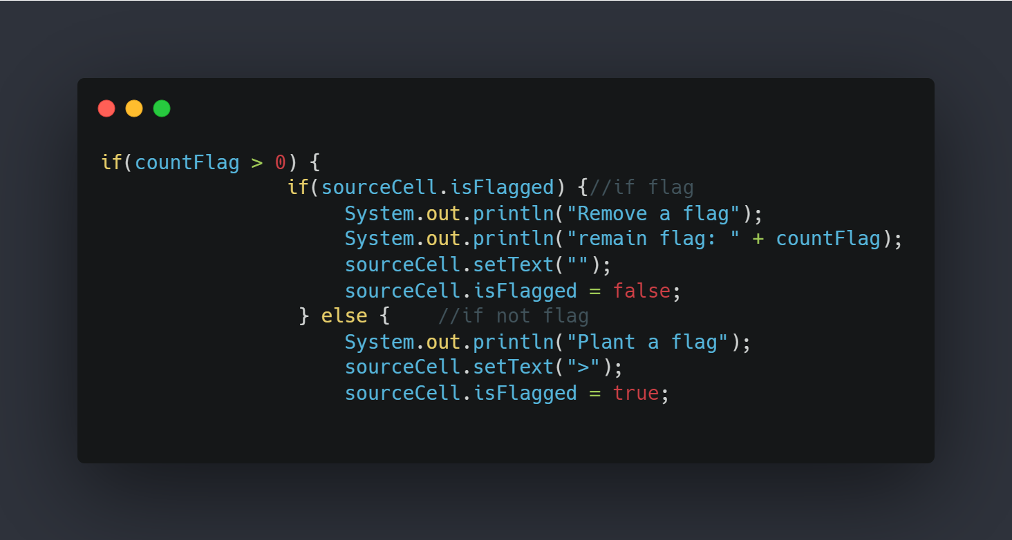
Additional Features {
forbeginners.html
workshop.css
Ability of the flag to lift a landmine when it finds it
Source Code photo
}
Programming Language

Slide 31
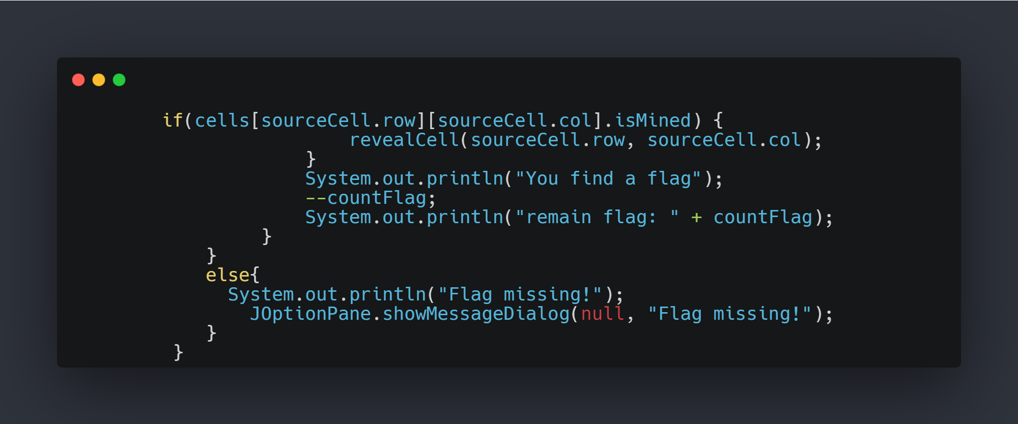
Additional Features {
forbeginners.html
workshop.css
Ability of the flag to lift a landmine when it finds it
Source Code photo
}
Programming Language

Slide 32
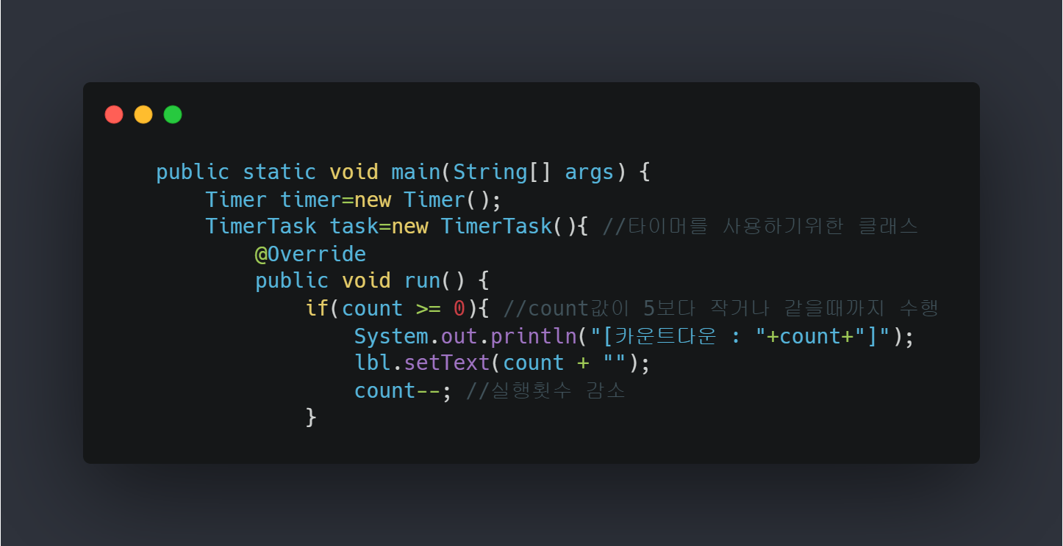
Additional Features {
forbeginners.html
workshop.css
Ability to Timer
Source Code photo
}
Programming Language

Slide 33
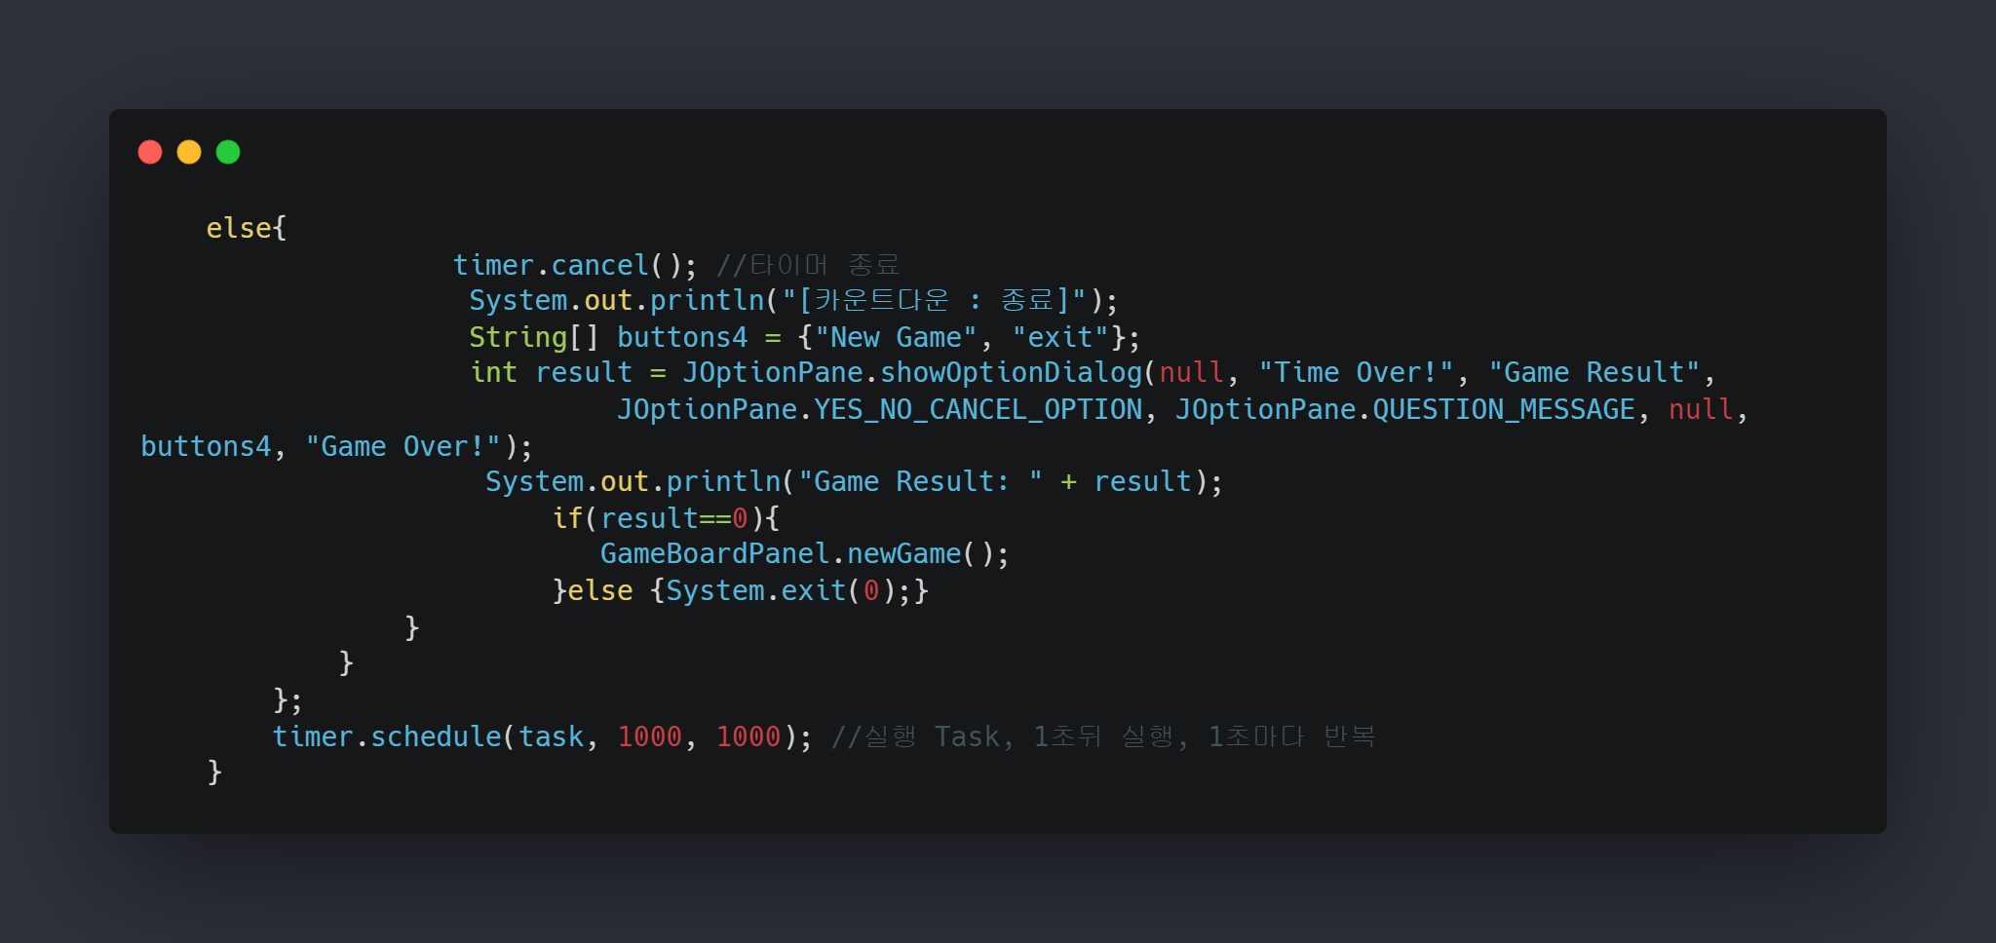
Additional Features {
forbeginners.html
workshop.css
Ability to Timer
Source Code photo
}
Programming Language

Slide 34
05 {
[Role Sharing]
forbeginners.html
workshop.css
}
Programming Language

Slide 35
Role Sharing{
forbeginners.html
workshop.css
2020136135
한송이
<Write code >
<Project presentation>
2020136025
김예원
2019136048
김형진
2020136149
김태섭
< Write report >
<Make PPT>
}
Programming Language

Slide 36
Thanks {
forbeginners.html
workshop.css
‘Do you have any questions?’
}
Programming Language

